Slide 1
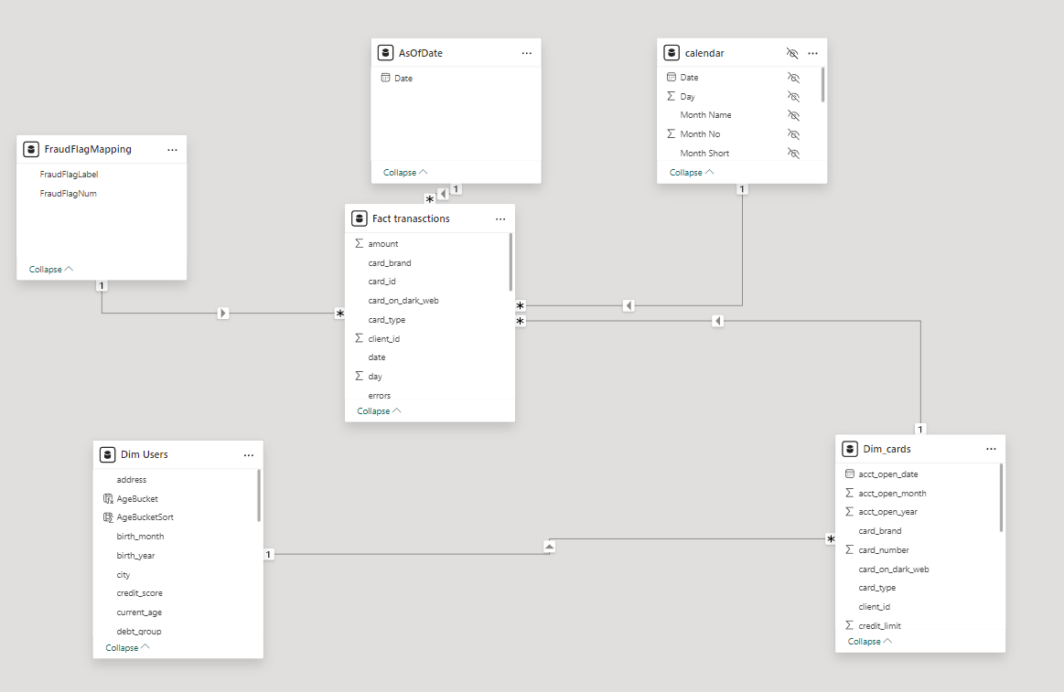
"Sneak Peek at Dashboard Construction Before Diving In."

Slide 2
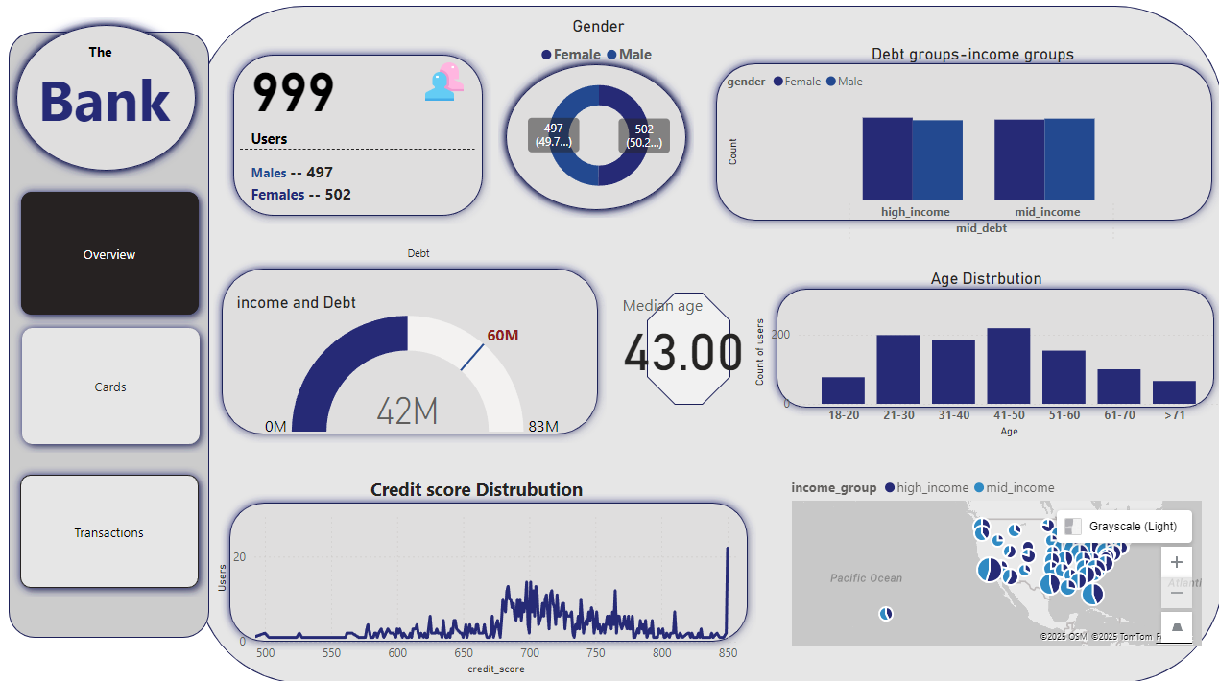
Page: “OverView”
Consists of information related to user Behaviors and Distributions

Slide 3
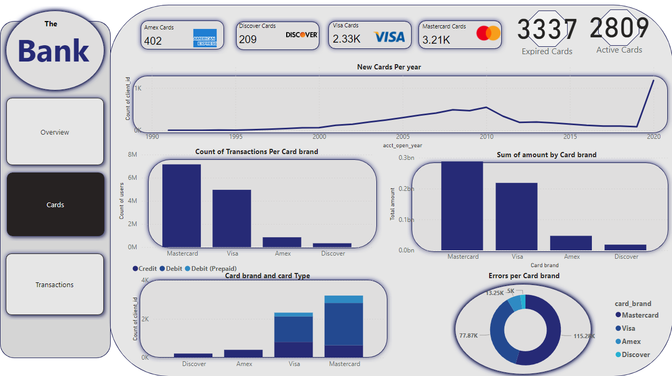
Page: “Cards”
Consists of information related to Cards as an object And relative usage frequency

Slide 4
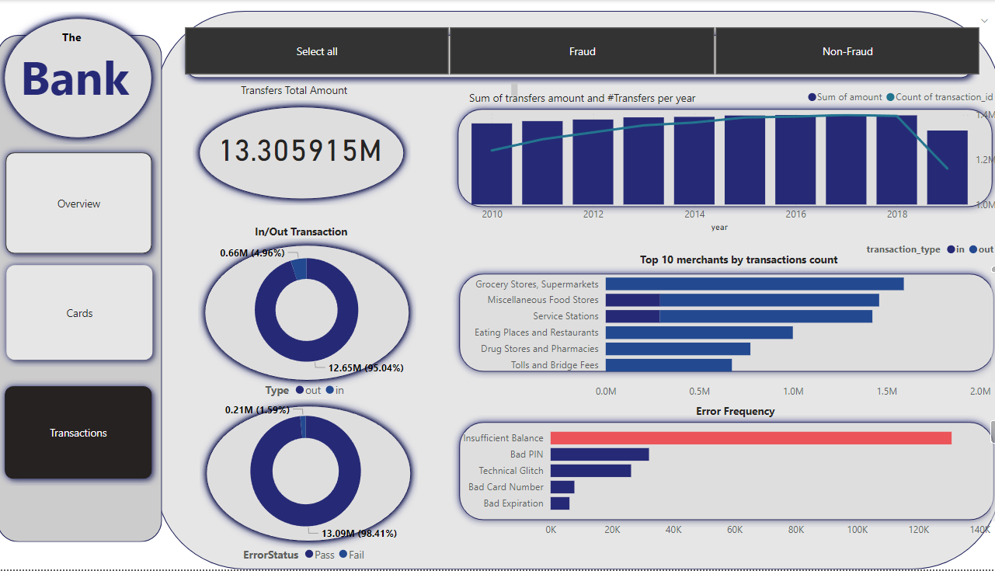
Page: “Transactions”
All Transactions related information, with Filter to select/exclude Fraud transactions.

Slide 5

💳 Financial Transactions Dataset: Analytics
This analysis will aim towards recognizing overall user behavior, and how to gain more users

Slide 6

Objective: Understand customer and transaction behavior. in the past 10 years. with the goal of identifying ways to increase the number of users

Slide 7
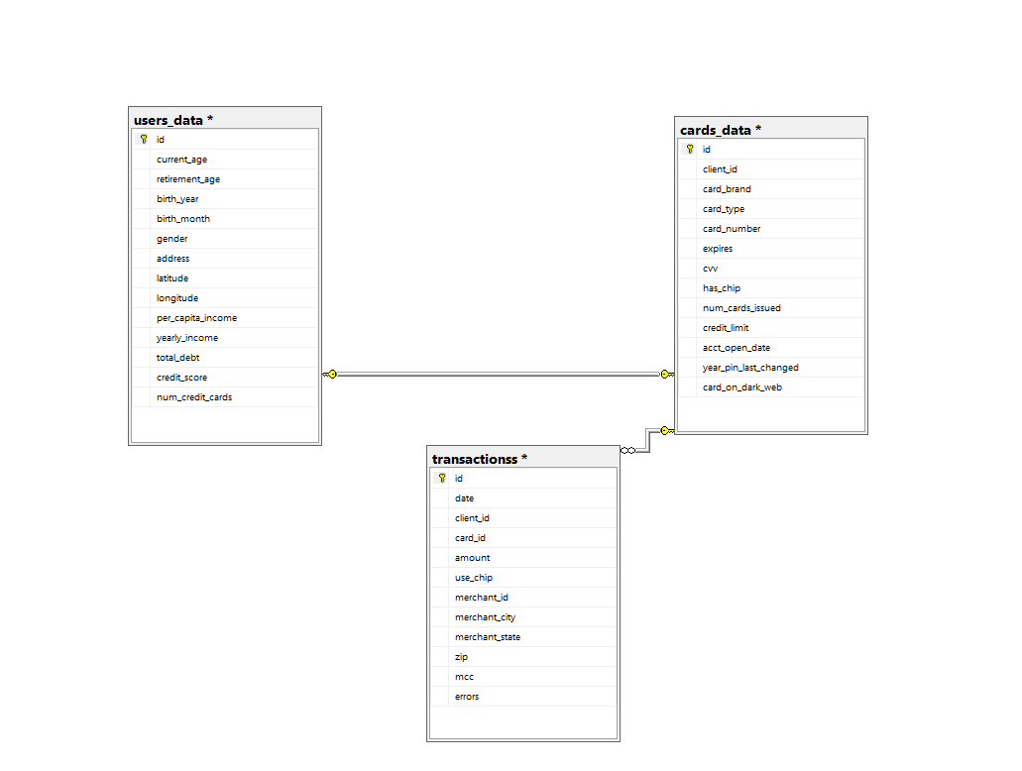
Data was exported using SQL

Slide 8
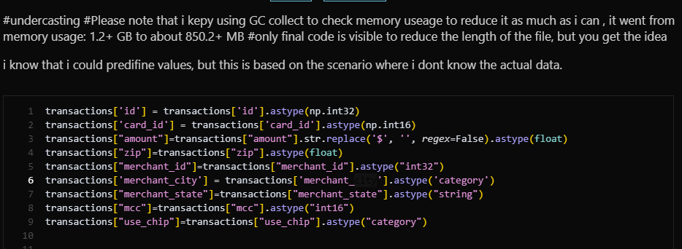
Under casting to reduce memory usage

Slide 9
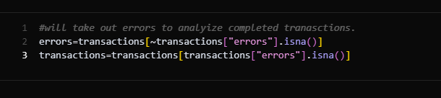
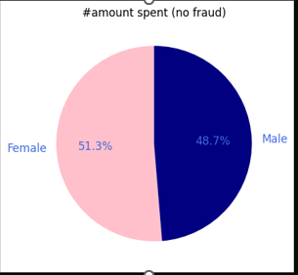
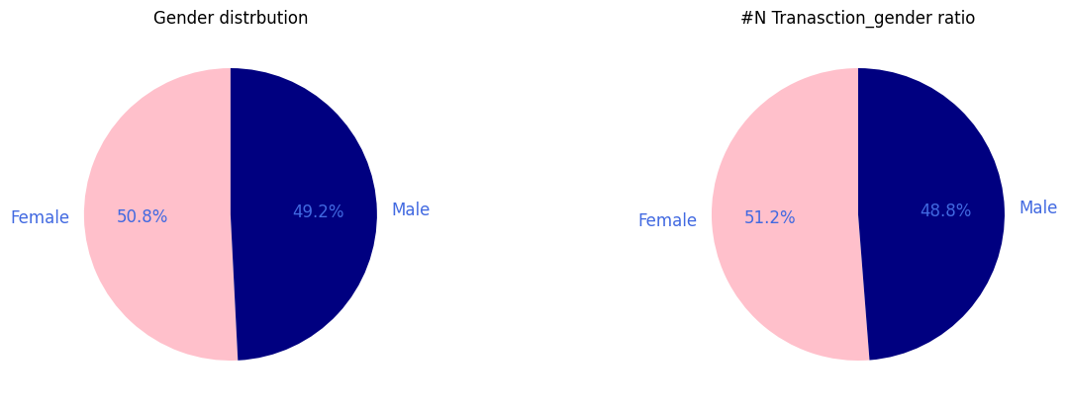
Separating errors and Actual transactions
Gender ratio

Slide 10
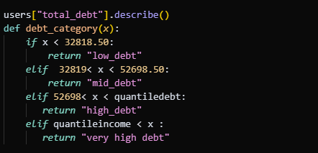
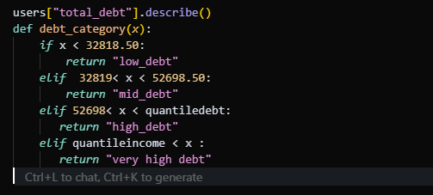
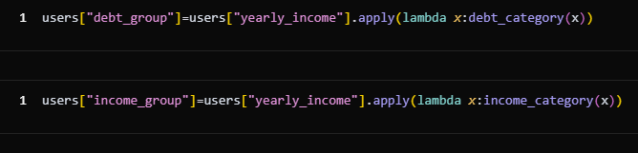
Categorizing income group based on quanitle considering quanitle 85% as a start for very high income/deb

Slide 11

Fastforward to insights

Slide 12
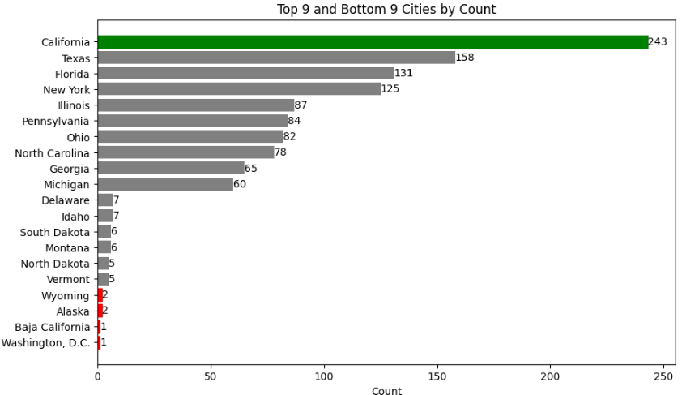
Where are our most users?
About 243 of the total users reside in California, while only 1 user resides in Washington, D.C. Advertisement campaigns in Washington could significantly increase the number of users.

Slide 13
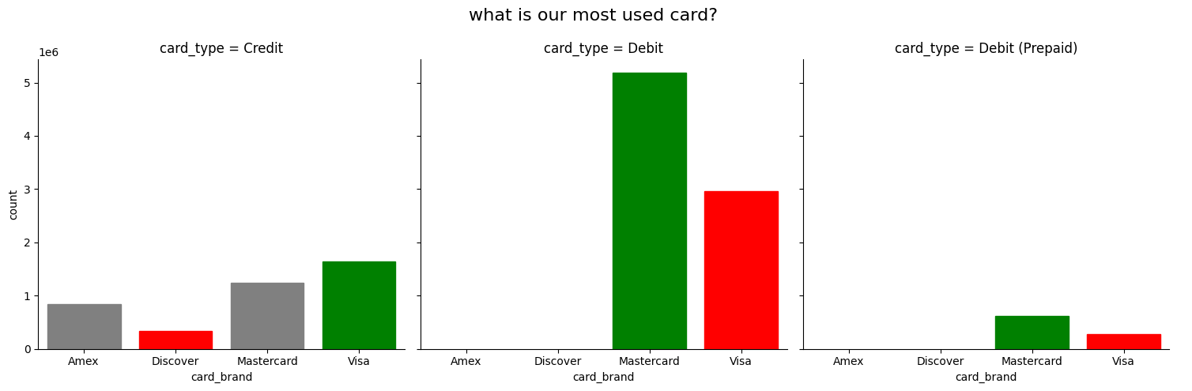
What are the most used cards in regards to transaction counts
Clients prefer master card for debit and prepaid cards, but prefer visa cards for credit cards

Slide 14
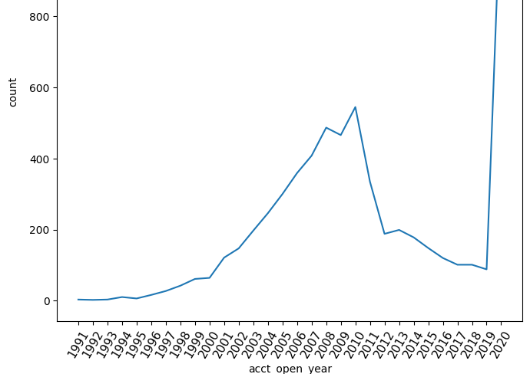
How many new cards have been issued in the last couple of years
1178 new cards got issued in the last year. Which is signifyingly more than last year

Slide 15
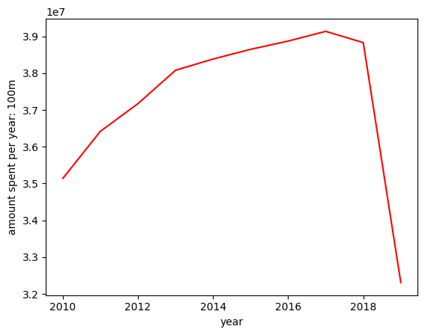
How have the number of transactions changed over the past years?
The number of transactions has been increasing each year. The drop observed in 2020 is due to incomplete data for that year

Slide 16
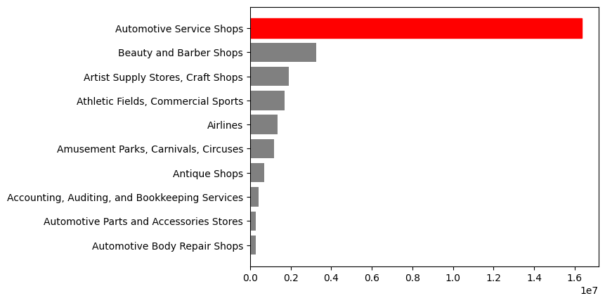
What are these amounts spent on?
Most of the spending goes to automotive service shops.
Partnerships with car insurance companies could be considered to attract more users.

Slide 17
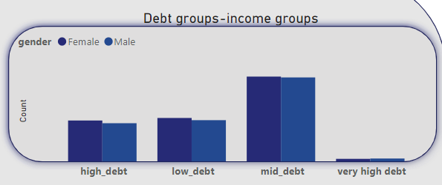
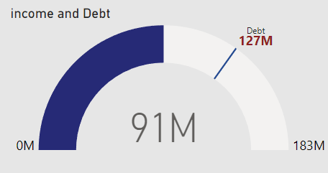
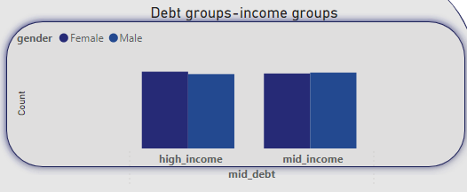
What does the debt distribution across clients look like?
We can see that most of our client base falls into the mid-debt category, also the total yearly income isn’t sufficient to cover total debt, which may cause long-term issues. Drilling into the mid-debt group, we find it consists of both high- and mid-income categories.

Slide 18
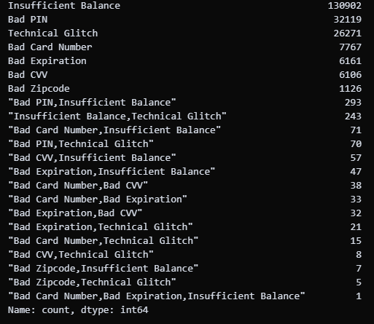
What about errors?
A large portion of errors are caused by insufficient balances. However, it is worth noting that there are also numerous technical glitches—about 200 per year. The tech team may need to be contacted.

Slide 19
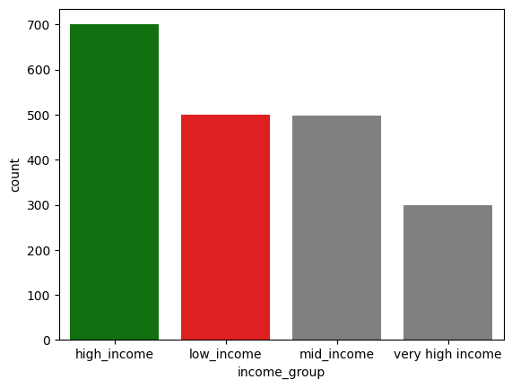
Q: What is the highest count of clients by income category?
The high-income group which consists of nearly 700 clients.

Slide 20

Fraud behavior

Slide 21
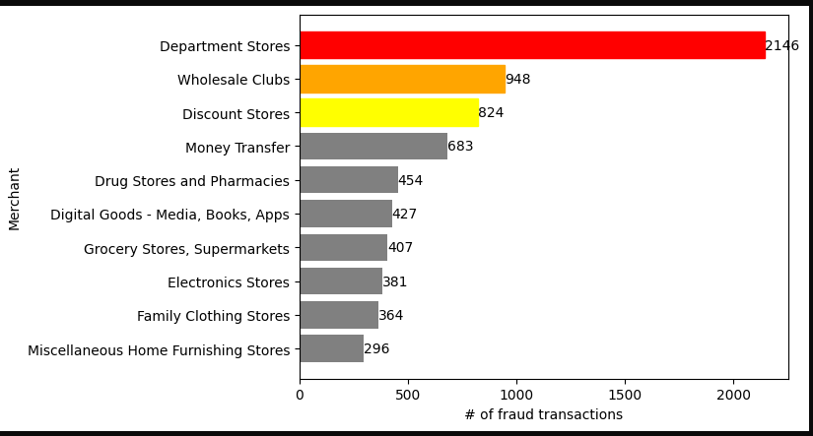
"Most fraud transactions, paid to department stores and wholesale clubs, are very likely gift card purchases."

Slide 22
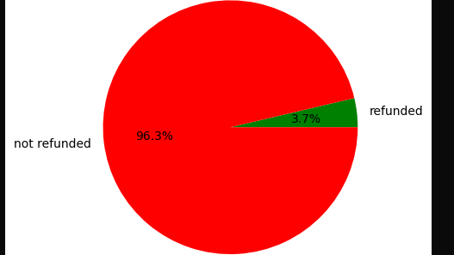
Only 3.7% of fraud transactions were refunded

